Slide 1
BBM 301 – Programming Languages Lecture 3

Slide 2
Where We Are
Source Code
Lexical Analysis
Syntax Analysis
Semantic Analysis
IR Generation
IR Optimization
Code Generation
Optimization
Machine Code

Slide 3
Where We Are
Source Code
Lexical Analysis
Syntax Analysis
Semantic Analysis
IR Generation
IR Optimization
Code Generation
Optimization
Machine Code

Slide 4
What is Syntax Analysis?
After lexical analysis (scanning), we have a series of tokens.
In syntax analysis (or parsing), we want to interpret what those tokens mean.
Goal: Recover the structure described by that series of tokens.
Goal: Report errors if those tokens do not properly encode a structure.

Slide 5
Lexical vs. Syntactic Analysis
Phase | Input | Output
Lexer | Sequence of characters | Sequence of tokens
Parser | Sequence of tokens | Parse tree
Lex is a tool for writing lexical analyzers.
Yacc is a tool for constructing parsers.
Slide credit: Wes Weimer
5

Slide 6
while (ip < z)
++ip;

Slide 7
w | h | i | l | e |  | ( | i | p |  | < |  | z | ) | \n | \t | + | + | i | p | ;
+
while
(ip
<
z)
++ip;

Slide 8
T_While
(
T_Ident
<
T_Ident
)
++
T_Ident
ip
z
ip
w | h | i | l | e |  | ( | i | p |  | < |  | z | ) | \n | \t | + | + | i | p | ;
+
while
(ip
<
z)
++ip;

Slide 9
While
<
++
Ident ip
Ident
z
Ident ip
T_While
(
T_Ident
<
T_Ident
)
++
T_Ident
ip
z
ip
w | h | i | l | e |  | ( | i | p |  | < |  | z | ) | \n | \t | + | + | i | p | ;
+
while
(ip
<
z)
++ip;

Slide 10
do[for] = new 0;

Slide 11
d | o | [ | f | o | r | ] |  | = |  | n | e | w |  | 0 | ;
do[for]
=
new
0;

Slide 12
T_Do
[
T_For
]
=
T_New
T_IntConst
0
d | o | [ | f | o | r | ] |  | = |  | n | e | w |  | 0 | ;
do[for]
=
new
0;

Slide 13


T_Do
[
T_For
]
=
T_New
T_IntConst
0
d | o | [ | f | o | r | ] |  | = |  | n | e | w |  | 0 | ;
do[for]
=
new
0;

Slide 14
Describing Syntax
Higher level constructs are given by syntax rules.
Syntax rules specify which strings from Σ* are in the language
Examples: organization of the program, loop structures, assignment, expressions, subprogram definitions, and calls.

Slide 15
Formal Languages
●
An alphabet is a set Σ of symbols that act as letters.
A language over Σ is a set of strings made from symbols in Σ.
When scanning, our alphabet was ASCII or Unicode characters. We produced tokens.
When parsing, our alphabet is the set of tokens produced by the scanner.
●
●
●

Slide 16
The Limits of Regular Languages
When scanning, we used regular expressions to define each token.
Unfortunately, regular expressions are (usually) too weak to define programming languages.
●
●
●
Cannot define a regular expression matching all expressions with properly balanced parentheses.
Cannot define a regular expression matching all functions with properly nested block structure.
●
●
We need a more powerful formalism.

Slide 17
Context-Free Grammars
●
A context-free grammar (or CFG) is a formalism for defining languages.
Can define the context-free languages, a strict superset of the the regular languages.
●

Slide 18
L = {one or more zeros followed by one or more ones}
0⁺1⁺ : Regular expression
S -> AB
A-> 0A | 0
B-> 1B | 1

Slide 19
Is the following language regular?
L = {number of 0s followed by equal number of 1s}
L = {0^{n}1^{n}, n>=0}

Slide 20
Context Free Grammars
L = {a^{n}b^{n}, n>=0 }
S -> aSb | empty
L = {a^{n}b^{n}, n>=1 }
S -> aSb | ab

Slide 21
Not Notational Shorthand
●
The syntax for regular expressions does not carry over to CFGs.
Cannot use *, |, or parentheses.
●
S → a*b

Slide 22
Not Notational Shorthand
●
The syntax for regular expressions does not carry over to CFGs.
Cannot use *, |, or parentheses.
●
S → Ab

Slide 23
Not Notational Shorthand
●
The syntax for regular expressions does not carry over to CFGs.
Cannot use *, |, or parentheses.
●
S → Ab
A → Aa | ε

Slide 24
Not Notational Shorthand
●
The syntax for regular expressions does not carry over to CFGs.
Cannot use *, |, or parentheses.
●
S → a(b|c*)

Slide 25
Not Notational Shorthand
●
The syntax for regular expressions does not carry over to CFGs.
Cannot use *, |, or parentheses.
●
S → aX
X → (b|c*)

Slide 26
Not Notational Shorthand
●
The syntax for regular expressions does not carry over to CFGs.
Cannot use *, |, or parentheses.
●
S → aX
X → b | c*

Slide 27
Not Notational Shorthand
●
The syntax for regular expressions does not carry over to CFGs.
Cannot use *, |, or parentheses.
●
S → aX
X → b | C

Slide 28
Not Notational Shorthand
●
The syntax for regular expressions does not carry over to CFGs.
Cannot use *, |, or parentheses.
●
S → aX
X → b | C C → Cc | ε

Slide 29
Context-Free Grammars
Context-Free Grammars
Developed by Noam Chomsky in the mid-1950s
Language generators, meant to describe the syntax of natural languages
Define the class of context-free languages
Programming languages are contained in the class of CFL’s.
Notes:
29

Slide 30
Elements of Syntax
An alphabet of symbols
Symbols are terminal and non-terminal
Terminals cannot be broken down
Non-terminals can be broken down further
Grammar rules that express how symbols are combined to make legal sentences
Rules are of the general form
non-terminal -> list of zero or more terminals or non-terminals
One uses rules to recognize (parse) or generate legal sentences

Slide 31
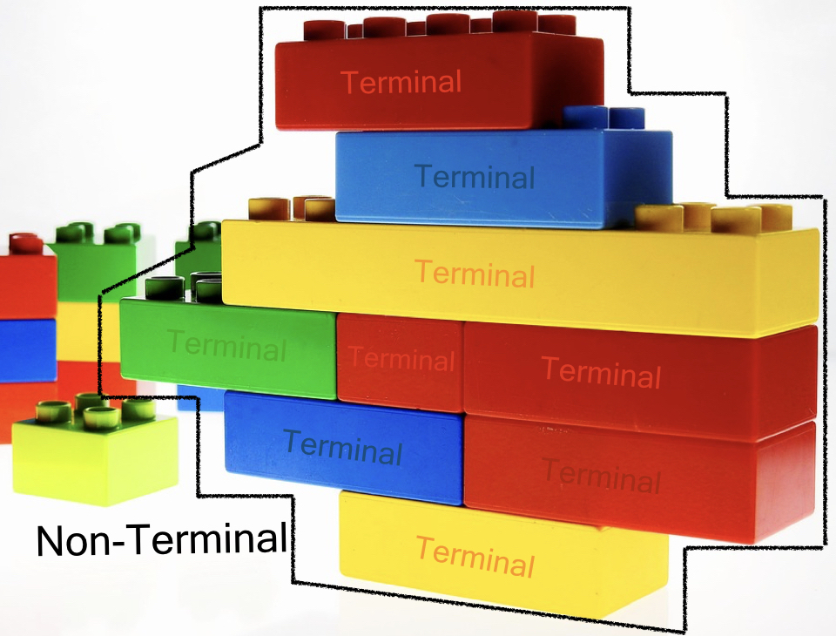
Additional Notes on Terminals and NonTerminals
Source: https://tomassetti.me/ebnf/

Slide 32
Backus-Naur Form (BNF)
A notation to describe the syntax of programming languages.
Named after
John Backus – Algol 58
Peter Naur – Algol 60
A metalanguage is a language used to describe another language.
BNF is a metalanguage used to describe PLs.

Slide 33
BNF Fundamentals
BNF uses abstractions for syntactic structures.
<LHS> → <RHS>
LHS: abstraction being defined
RHS: definition
“→” means “can have the form”
Sometimes ::= is used for →

Slide 34
BNF Fundamentals
Example, Java assignment statement can be represented by the abstraction <assign>
<assign> → <var> = <expression>
This is a rule or production
Here, <var> and <expression> must also be defined.
example instances of this abstraction can be
total = sub1 + sub2
myVar = 4

Slide 35
BNF Fundamentals
These abstractions are called Variables or Nonterminals of a Grammar.
Lexemes and tokens are the Terminals of a grammar.
Nonterminals are often enclosed in angle brackets
Examples of BNF rules:
<ident_list> → identifier | identifier, <ident_list>
<if_stmt> → if <logic_expr> then <stmt>

Slide 36
BNF Fundamentals
A formal definition of rule:
A rule has a left-hand side (LHS), which is a nonterminal, and a right-hand side (RHS), which is a string of terminals and/or nonterminals
<LHS> → <RHS>
Grammar: a finite non-empty set of rules

Slide 37
Terminals
Let’s see some typical terminals:
identifiers: these are the names used for variables, classes, functions, methods and so on.
keywords: almost every language uses keywords. They are exact strings that are used to indicate the start of a definition (think about class in Java or def in Python), a modifier (public, private, static, final, etc.) or control flow structures (while, for, until, etc.)

Slide 38
Terminals
literals: these permit to define values in our languages. We can have string literals, numeric literal, char literals, boolean literals (but we could consider them keywords as well), array literals, map literals, and more, depending on the language
separators and delimiters: like colons, semicolons, commas, parenthesis, brackets, braces
whitespaces: spaces, tabs, newlines.
comments

Slide 39
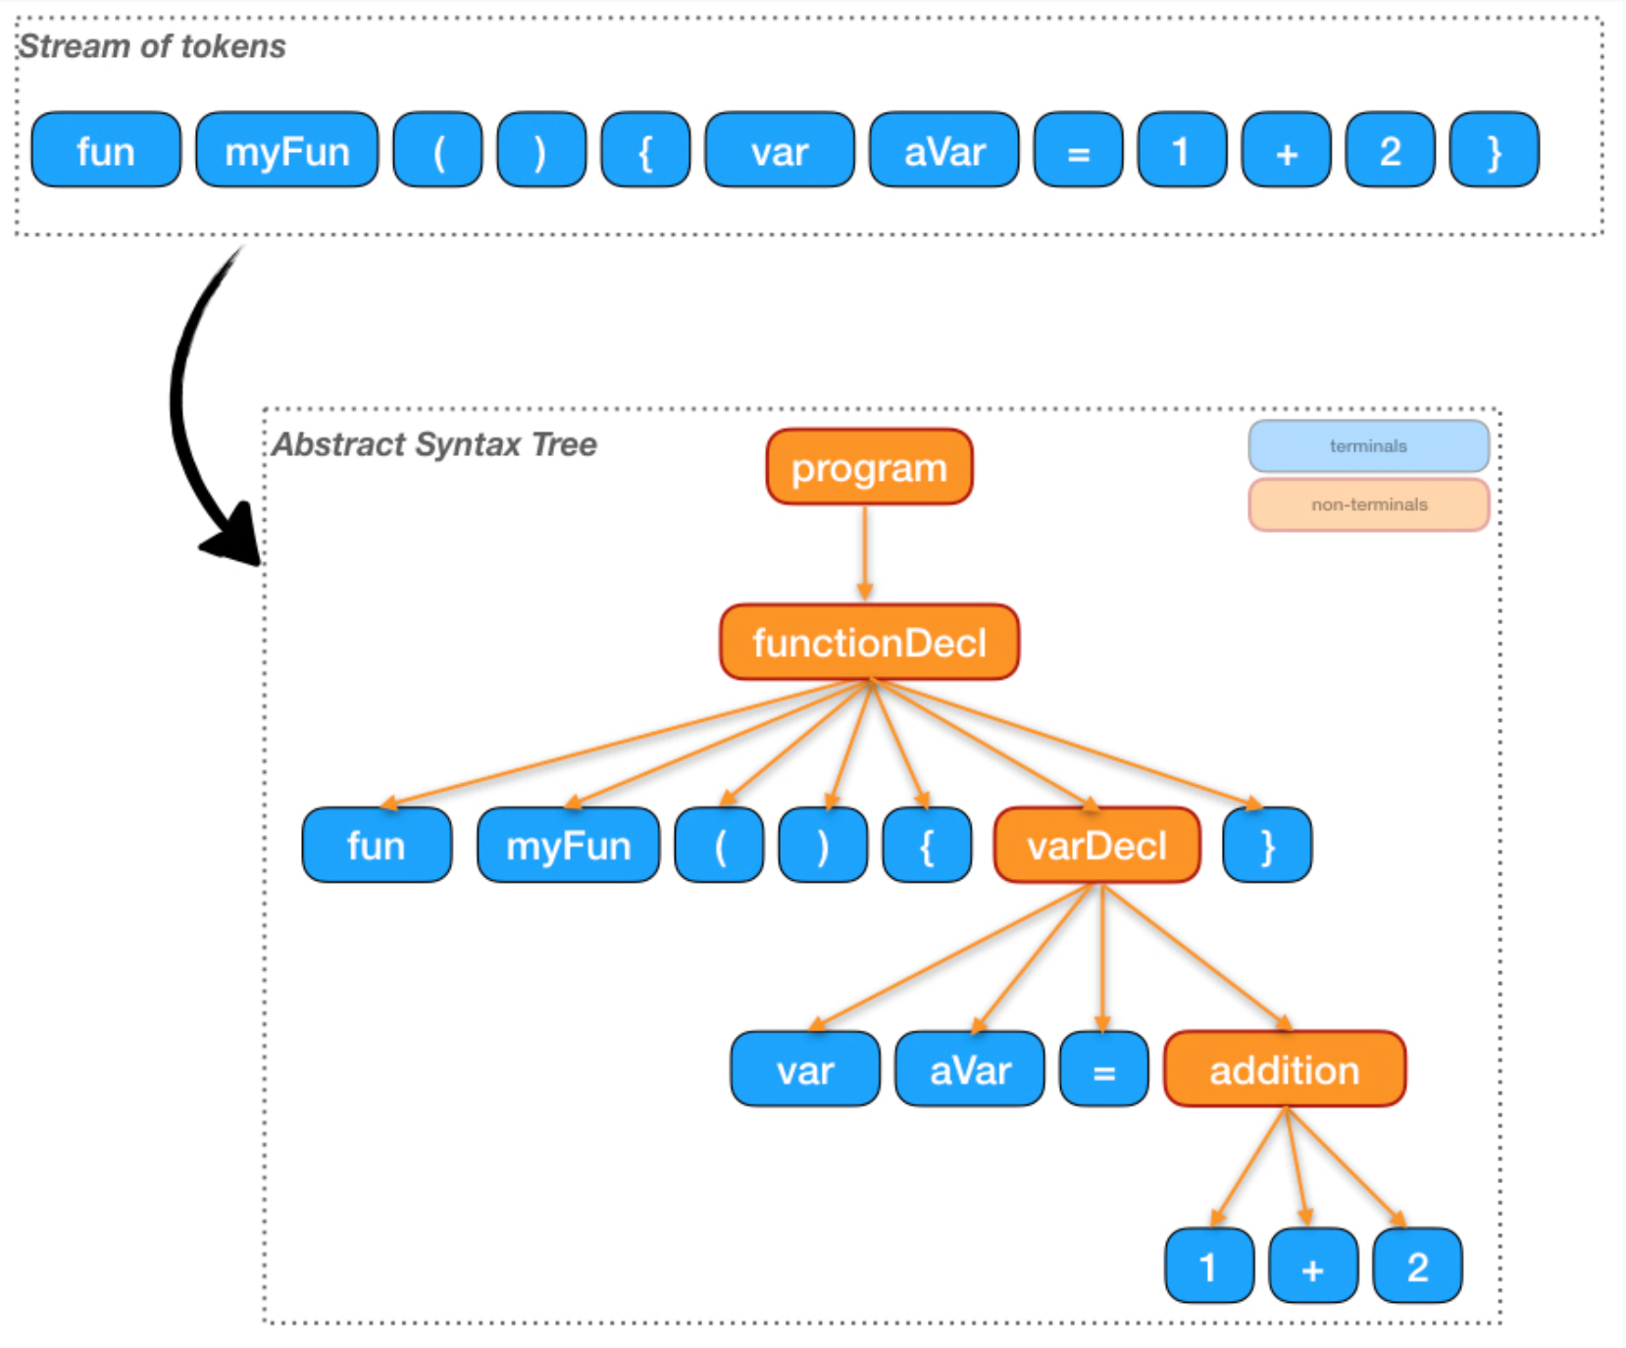
Terminals and Non-terminals
Source: https://tomassetti.me/ebnf/

Slide 40
Non-terminals
Examples of non-terminals are:
program/document: represent the entire file
module/classes: group several declarations togethers
functions/methods: group statements together
statements: these are the single instructions. Some of them can contain other statements. Example : loops
expressions: are typically used within statements and can be composed in various ways

Slide 41
Examples

Slide 42
An initial example
Consider the sentence “Mary greets John”
A simple grammar
<sentence> ::= <subject><predicate>
<subject> ::= Mary
<predicate> ::= <verb><object>
<verb> ::= greets
<object> ::= John

Slide 43
Alternations
Multiple definitions can be separated by | (OR).
<object> ::= John | Alfred
This adds “Mary greets Alfred” to legal sentences
<subject> ::= Mary | John | Alfred
<object> ::= Mary | John | Alfred
Alternation to the previous grammar
<sentence> ::= <subject><predicate>
<subject> ::= <noun>
<predicate> ::= <verb><object>
<verb> ::= greets
<object> ::= <noun>
<noun> ::= Mary | John | Alfred

Slide 44
Infinite Number of Sentences
<object> ::= John |
John again |
John again and again |
….
Instead use recursive definition
<object> ::= John |
John <repeat factor>
<repeat factor> ::= again |
again and <repeat factor>
A rule is recursive if its LHS appears in its RHS

Slide 45
Identifiers
<identifier> → <letter> |
<identifier><letter> |
<identifier><digit>

Slide 46
PASCAL/Ada If Statement
<if_stmt> → if <logic_expr> then <stmt>
<if_stmt> → if <logic_expr> then <stmt> else <stmt>
Or
<if_stmt> → if <logic_expr> then <stmt>
| if <logic_expr> then <stmt> else <stmt>

Slide 47
Another example

Slide 48
Arithmetic Expressions
●
Suppose we want to describe all legal arithmetic expressions using addition, subtraction, multiplication, and division.
Here is one possible CFG:
●
E → int
E → E Op E E → (E)
Op → + Op → - Op → * Op → /
E
⇒ E Op E
⇒ E Op int
⇒ int Op int
⇒ int / int

Slide 49
Arithmetic Expressions
●
Suppose we want to describe all legal arithmetic expressions using addition, subtraction, multiplication, and division.
Here is one possible CFG:
●
E → int
E → E Op E E → (E)
Op → + Op → - Op → * Op → /
E
⇒ E Op E
⇒ E Op (E)
⇒ E Op (E Op E)
⇒ E * (E Op E)
⇒ int * (E Op E)
⇒ int * (int Op E)
⇒ int * (int Op int)
⇒ int * (int + int)

Slide 50
Context-Free Grammars
E → int
E → E Op E E → (E)
Op → + Op → - Op → * Op → /
Formally, a context-free grammar is a collection of four objects:
A set of nonterminal symbols
(or variables),
A set of terminal symbols,
A set of production rules saying how each nonterminal can be converted by a string of terminals and nonterminals, and
A start symbol that begins the derivation.
●
●
●

Slide 51
A Notational Shorthand
E → int
E → E Op E E → (E)
Op → + Op → - Op → * Op → /

Slide 52
A Notational Shorthand
E → int | E Op E | (E)
Op → + | - | * | /

Slide 53
Derivations
E
⇒ E Op E
⇒ E Op (E)
⇒ E Op (E Op E)
⇒ E * (E Op E)
⇒ int * (E Op E)
⇒ int * (int Op E)
This sequence of steps is called a derivation.
A string αAω yields string
αγω iff A → γ is a production.
If α yields β, we write α ⇒ β.
We say that α derives β iff there is a sequence of strings
⇒ int * (int Op int)
⇒ int * (int + int)
where
α ⇒ α₁ ⇒ α₂ ⇒ … ⇒ β
If α derives β, we write α ⇒* β.

Slide 54
Related Derivations
E → int | E Op E | (E)
Op → + | - | * | /
E
⇒ E Op E
⇒ int Op E
⇒ int * E
⇒ int * (E)
⇒ int * (E Op E)
⇒ int * (int Op E)
⇒ int * (int + E)
⇒ int * (int + int)
E
⇒ E Op E
⇒ E Op (E)
⇒ E Op (E Op E)
⇒ E Op (E Op int)
⇒ E Op (E + int)
⇒ E Op (int + int)
⇒ E * (int + int)
⇒ int * (int + int)

Slide 55
Grammars and Derivations
A grammar is a generative device for defining languages
The sentences of the language are generated through a sequence of applications of the rules, starting from the special nonterminal called start symbol.
Such a generation is called a derivation.
Start symbol represents a complete program. So it is usually named as <program>.

Slide 56
An Example Grammar
<program> → begin <stmt_list> end
<stmt_list> → <stmt> |
<stmt> ; <stmt_list>
<stmt> → <var> := <expression>
<var> → A | B | C
<expression>→ <var> |
<var> <arith_op> <var>
<arith_op> → + | - | * | /
Notes:
56

Slide 57
Derivation
In order to check if a given string represents a valid program in the language, we try to derive it in the grammar.
Derivation starts from the start symbol <program>.
At each step we replace a nonterminal with its definition (RHS of the rule).

Slide 58
Derivations
Every string of symbols in a derivation is a sentential form
A sentence is a sentential form that has only terminal symbols
A leftmost derivation is one in which the leftmost nonterminal in each sentential form is the one that is expanded
A derivation may be neither leftmost nor rightmost

Slide 59
Leftmost Derivations
●
A leftmost derivation is a derivation in which each step expands the leftmost nonterminal.
A rightmost derivation is a derivation in which each step expands the rightmost nonterminal.
●
●

Slide 60
An Example Derivation

Slide 61
An Example Derivation
Derive string: begin A := B; C := A * B end
<program> ⇒ begin <stmt_list> end
⇒ begin <stmt> ; <stmt_list> end
⇒ begin <var> := <expression>; <stmt_list> end
⇒ begin A := <expression>; <stmt_list> end
⇒ begin A := B; <stmt_list> end
⇒ begin A := B; <stmt> end
⇒ begin A := B; <var> := <expression> end
⇒ begin A := B; C := <expression> end
⇒ begin A := B; C := <var><arith_op><var> end
⇒ begin A := B; C := A <arith_op> <var> end
⇒ begin A := B; C := A * <var> end
⇒ begin A := B; C := A * B end
sentential
form
If always the leftmost nonterminal is replaced, then it is called leftmost derivation.

Slide 62
<program> → begin <stmt_list> end
<stmt_list> → <stmt> | <stmt> ; <stmt_list>
<stmt> → <var> := <expression>
<var> → A | B | C
<expression>→ <var> | <var> <arith_op> <var>
<arith_op> → + | - | * | /
Derive string:
begin A := B; C := A * B end
<program> ⇒ begin <stmt_list> end
Leftmost derivation
⇒ begin <stmt> ; <stmt_list> end
⇒ begin <var> := <expression>; <stmt_list> end
Rightmost derivation
⇒ begin <stmt> ; <stmt_list> end
⇒ begin <stmt>; <stmt> end

Slide 63
<program> → begin <stmt_list> end
<stmt_list> → <stmt> | <stmt> ; <stmt_list>
<stmt> → <var> := <expression>
<var> → A | B | C
<expression>→ <var> | <var> <arith_op> <var>
<arith_op> → + | - | * | /
Derive string:
begin A := B; C := A * B end
<program> ⇒ begin <stmt_list> end
⇒ begin <stmt> ; <stmt_list> end
⇒ begin <var> := <expression>; <stmt_list> end
⇒ begin A := <expression>; <stmt_list> end
⇒ begin A := B; <stmt_list> end
⇒ begin A := B; <stmt> end
⇒ begin A := B; <var> := <expression> end
⇒ begin A := B; C := <expression> end
⇒ begin A := B; C := <var><arith_op><var> end
⇒ begin A := B; C := A <arith_op> <var> end
⇒ begin A := B; C := A * <var> end
⇒ begin A := B; C := A * B end
If always the leftmost nonterminal is replaced, then it is called leftmost derivation.

Slide 64
<program> → begin <stmt_list> end
<stmt_list> → <stmt> | <stmt> ; <stmt_list>
<stmt> → <var> := <expression>
<var> → A | B | C
<expression>→ <var> | <var> <arith_op> <var>
<arith_op> → + | - | * | /
Derive string:
begin A := B; C := A * B end
<program> ⇒ begin <stmt_list> end
⇒ begin <stmt> ; <stmt_list> end
⇒ begin <stmt> ; <stmt> end
⇒ begin <stmt> ; <var> := <expression> end
⇒ begin <stmt> ; <var> := <var><arith_op><var> end
⇒ begin <stmt> ; <var> := <var><arith_op> B end
⇒ begin <stmt> ; <var> := <var> * B end
⇒ begin <stmt> ; <var> := A * B end
⇒ begin <stmt> ; C := A * B end
⇒ begin <var> := <expression>; C := A * B end
⇒ begin <var> := <var>; C := A * B end
⇒ begin <var> := B ; C := A * B end
⇒ begin A := B; C := A * B end
If always the rightmost nonterminal is replaced, then it is called rightmost derivation.

Slide 65
<program> → begin <stmt_list> end
<stmt_list> → <stmt> | <stmt> ; <stmt_list>
<stmt> → <var> := <expression>
<var> → A | B | C
<expression>→ <var> | <var> <arith_op> <var>
<arith_op> → + | - | * | /
Derive string:
begin A := B; C := A * B end
<program> ⇒ begin <stmt_list> end
⇒ begin <stmt> ; <stmt_list> end
⇒ begin <var> := <expression>; <stmt_list> end
⇒ begin A := <expression>; <stmt_list> end
⇒ begin A := B; <stmt_list> end
⇒ begin A := B; <stmt> end
⇒ begin A := B; <var> := <expression> end
⇒ begin A := B; C := <expression> end
⇒ begin A := B; C := <var><arith_op><var> end
⇒ begin A := B; C := A <arith_op> <var> end
⇒ begin A := B; C := A * <var> end
⇒ begin A := B; C := A * B end
Leftmost derivation
<program> ⇒ begin <stmt_list> end
⇒ begin <stmt> ; <stmt_list> end
⇒ begin <stmt> ; <stmt> end
⇒ begin <stmt> ; <var> := <expression> end
⇒ begin <stmt> ; <var> := <var><arith_op><var> end
⇒ begin <stmt> ; <var> := <var><arith_op> B end
⇒ begin <stmt> ; <var> := <var> * B end
⇒ begin <stmt> ; <var> := A * B end
⇒ begin <stmt> ; C := A * B end
⇒ begin <var> := <expression>; C := A * B end
⇒ begin <var> := <var>; C := A * B end
⇒ begin <var> := B ; C := A * B end
⇒ begin A := B; C := A * B end
Rightmost derivation

Slide 66
Related Derivations
E → int | E Op E | (E)
Op → + | - | * | /
E
⇒ E Op E
⇒ int Op E
⇒ int * E
⇒ int * (E)
⇒ int * (E Op E)
⇒ int * (int Op E)
⇒ int * (int + E)
⇒ int * (int + int)
E
⇒ E Op E
⇒ E Op (E)
⇒ E Op (E Op E)
⇒ E Op (E Op int)
⇒ E Op (E + int)
⇒ E Op (int + int)
⇒ E * (int + int)
⇒ int * (int + int)

Slide 67
Derivations Revisited
●
A derivation encodes two pieces of information:
●
What productions were applied produce the resulting string from the start symbol?
In what order were they applied?
●
●
Multiple derivations might use the same productions, but apply them in a different order.

Slide 68
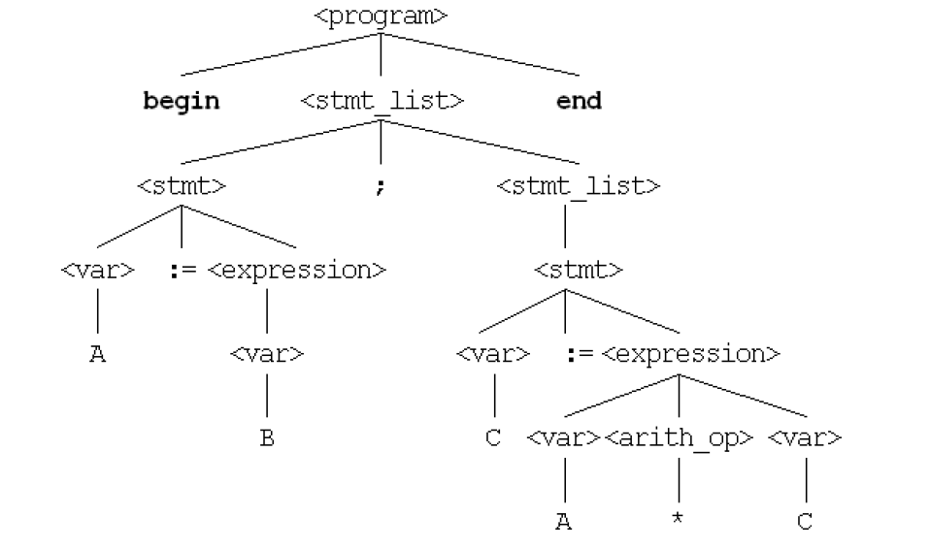
Parse Tree
A hierarchical
representation of a
derivation
<program> → begin <stmt_list> end
<stmt_list> → <stmt> | <stmt> ; <stmt_list>
<stmt> → <var> := <expression>
<var> → A | B | C
<expression>→ <var> | <var> <arith_op> <var>
<arith_op> → + | - | * | /
begin A := B; C := A * B end
B

Slide 69
Another Example
<program> → <stmt_list>
<stmt_list> → <stmt>
| <stmt> ; <stmt_list>
<stmt> → <var> = <expr>
<var> → a | b | c | d
<expr> → <term> + <term>
| <term> - <term>
<term> → <var> | const
a = b + const
<stmt_list>
<stmt>
<var> = <expr>
<var> = <term> + <term>
<var> = <term> + const
<var> = <var> + const
<var> = b + const
a = b + const
<program>
<stmt_list>
<stmt_list>
<stmt>
<var> = <expr>
a = <expr>
a = <term> + <term>
a = <var> + <term>
a = b + <term>
a = b + const
<stmt>
=
<expr>
<var>
a
<term>
+
<term>
<var>
const
a
b
Copyright © 2009 Addison-Wesley. All rights reserved.
1-69
Notes:
69

Slide 70
Arithmetic expressions revisited
E → int | E Op E | (E)
Op → + | - | * | /

Slide 71
Parse Trees
E

Slide 72
Parse Trees
E
E

Slide 73
Parse Trees
E
E
⇒ E Op E

Slide 74
Parse Trees
E
E
⇒ E Op E
E
Op
E

Slide 75
Parse Trees
E
E
⇒ E Op E
⇒ int Op E
E
Op
E

Slide 76
Parse Trees
E
E
⇒ E Op E
⇒ int Op E
E
Op
E
int

Slide 77
Parse Trees
E
E
⇒ E Op E
⇒ int Op E
⇒ int * E
E
Op
E
int

Slide 78
Parse Trees
E
E
⇒ E Op E
⇒ int Op E
⇒ int * E
E |  | Op
E
int
*

Slide 79
Parse Trees
E
E
⇒ E Op E
⇒ int Op E
⇒ int * E
⇒ int * (E)
E |  | Op
E
int
*

Slide 80
Parse Trees
E
E
⇒ E Op E
⇒ int Op E
⇒ int * E
⇒ int * (E)
E |  | Op
E
E
int | * | (
)

Slide 81
Parse Trees
E
E
⇒ E Op E
⇒ int Op E
⇒ int * E
⇒ int * (E)
⇒ int * (E Op E)
E |  | Op
E
E
int | * | (
)

Slide 82
Parse Trees
E
E
⇒ E Op E
⇒ int Op E
⇒ int * E
⇒ int * (E)
⇒ int * (E Op E)
E |  | Op
E
E
E
Op
E
int | * | (
)

Slide 83
Parse Trees
E
E
⇒ E Op E
⇒ int Op E
⇒ int * E
⇒ int * (E)
⇒ int * (E Op E)
⇒ int * (int Op E)
E |  | Op
E
E
E
Op
E
int | * | (
)

Slide 84
Parse Trees
E
E
⇒ E Op E
⇒ int Op E
⇒ int * E
⇒ int * (E)
⇒ int * (E Op E)
⇒ int * (int Op E)
E |  | Op
E
E
E
Op
E
int | * | ( | int
)

Slide 85
Parse Trees
E
E
⇒ E Op E
⇒ int Op E
⇒ int * E
⇒ int * (E)
⇒ int * (E Op E)
⇒ int * (int Op E)
⇒ int * (int + E)
E |  | Op
E
E
E
Op
E
int | * | ( | int
)

Slide 86
Parse Trees
E
E
⇒ E Op E
⇒ int Op E
⇒ int * E
⇒ int * (E)
⇒ int * (E Op E)
⇒ int * (int Op E)
⇒ int * (int + E)
E |  | Op
E
E
E
Op
E
int | * | ( | int | +
)

Slide 87
Parse Trees
E
E
⇒ E Op E
⇒ int Op E
⇒ int * E
⇒ int * (E)
⇒ int * (E Op E)
⇒ int * (int Op E)
⇒ int * (int + E)
⇒ int * (int + int)
E |  | Op
E
E
E
Op
E
int | * | ( | int | +
)

Slide 88
Parse Trees
E
E
⇒ E Op E
⇒ int Op E
⇒ int * E
⇒ int * (E)
⇒ int * (E Op E)
⇒ int * (int Op E)
⇒ int * (int + E)
⇒ int * (int + int)
E |  | Op
E
E
E |  | Op |  | E
int | * | ( | int | + | int | )

Slide 89
Parse Trees
E

Slide 90
Parse Trees
E
E

Slide 91
Parse Trees
E
E
⇒ E Op E

Slide 92
Parse Trees
E
E
⇒ E Op E
E
Op
E

Slide 93
Parse Trees
E
E
⇒ E Op E
⇒ E Op (E)
E
Op
E

Slide 94
Parse Trees
E
E
⇒ E Op E
⇒ E Op (E)
E
Op
E
E
(
)

Slide 95
Parse Trees
E
E
⇒ E Op E
⇒ E Op (E)
⇒ E Op (E Op E)
E
Op
E
E
(
)

Slide 96
Parse Trees
E
E
⇒ E Op E
⇒ E Op (E)
⇒ E Op (E Op E)
E
Op
E
E
E
Op
E
(
)

Slide 97
Parse Trees
E
E
⇒ E Op E
⇒ E Op (E)
⇒ E Op (E Op E)
⇒ E Op (E Op int)
E
Op
E
E
E
Op
E
(
)

Slide 98
Parse Trees
E
E
⇒ E Op E
⇒ E Op (E)
⇒ E Op (E Op E)
⇒ E Op (E Op int)
E
Op
E
E
E
Op
E
(
int
)

Slide 99
Parse Trees
E
E
⇒ E Op E
⇒ E Op (E)
⇒ E Op (E Op E)
⇒ E Op (E Op int)
⇒ E Op (E + int)
E
Op
E
E
E
Op
E
(
int
)

Slide 100
Parse Trees
E
E
⇒ E Op E
⇒ E Op (E)
⇒ E Op (E Op E)
⇒ E Op (E Op int)
⇒ E Op (E + int)
E
Op
E
E
E
Op
E
(
+ | int | )

Slide 101
Parse Trees
E
E
⇒ E Op E
⇒ E Op (E)
⇒ E Op (E Op E)
⇒ E Op (E Op int)
⇒ E Op (E + int)
⇒ E Op (int + int)
E
Op
E
E
E
Op
E
(
+ | int | )

Slide 102
Parse Trees
E
E
⇒ E Op E
⇒ E Op (E)
⇒ E Op (E Op E)
⇒ E Op (E Op int)
⇒ E Op (E + int)
⇒ E Op (int + int)
E
Op
E
E
E |  | Op |  | E
( | int | + | int | )

Slide 103
Parse Trees
E
E
⇒ E Op E
⇒ E Op (E)
⇒ E Op (E Op E)
⇒ E Op (E Op int)
⇒ E Op (E + int)
⇒ E Op (int + int)
⇒ E * (int + int)
E
Op
E
E
E |  | Op |  | E
( | int | + | int | )

Slide 104
Parse Trees
E
E
⇒ E Op E
⇒ E Op (E)
⇒ E Op (E Op E)
⇒ E Op (E Op int)
⇒ E Op (E + int)
⇒ E Op (int + int)
⇒ E * (int + int)
E | Op
E
E
E |  | Op |  | E
* | ( | int | + | int | )

Slide 105
Parse Trees
E
E
⇒ E Op E
⇒ E Op (E)
⇒ E Op (E Op E)
⇒ E Op (E Op int)
⇒ E Op (E + int)
⇒ E Op (int + int)
⇒ E * (int + int)
⇒ int * (int + int)
E | Op
E
E
E |  | Op |  | E
* | ( | int | + | int | )

Slide 106
Parse Trees
E
E
⇒ E Op E
⇒ E Op (E)
⇒ E Op (E Op E)
⇒ E Op (E Op int)
⇒ E Op (E + int)
⇒ E Op (int + int)
⇒ E * (int + int)
⇒ int * (int + int)
E |  | Op
E
E
E |  | Op |  | E
int | * | ( | int | + | int | )

Slide 107
For Comparison
E
E
E |  | Op
E
E |  | Op
E
E
E
E |  | Op |  | E
E |  | Op |  | E
int | * | ( | int | + | int | )
int | * | ( | int | + | int | )

Slide 108
Parse Trees
A parse tree is a tree encoding the steps in a derivation.
Internal nodes represent nonterminal symbols used in the production.
Inorder walk of the leaves contains the generated string.
Encodes what productions are used, not the order in which those productions are applied.

Slide 109
The Goal of Parsing
●
Goal of syntax analysis: Recover the structure described by a series of tokens.
If language is described as a CFG, goal is to recover a parse tree for the the input string.
●
Usually we do some simplifications on the tree; more on that later.
We'll discuss how to do this next week.
●
●

Slide 110
Exercise Simple example for PLs
<expr> ::= <expr> <operator> <expr> |<var>
< operator > ::= + | - | * | /
<var> ::= a | b | c | …
<var> ::= <signed number>
<signed number> ::= + <number> | - <number>
<number> ::= <number> <digit> | <digit>

Slide 111
Ambiguity (Belirsizlik) in Grammars
A grammar is ambiguous if and only if it generates a sentential form that has two or more distinct parse trees
Copyright © 2009 Addison-Wesley. All rights reserved.
1-111
Notes:
111

Slide 112
A Serious Problem
E → int | E Op E | (E)
Op → + | - | * | /
E
E
E |  | Op
E
E
Op |  | E
E |  | Op |  | E
E |  | Op |  | E
int | * | int | + | int
int | * | int | + | int
int * (int + int)
(int * int) + int

Slide 113
Ambiguity
A CFG is said to be ambiguous if there is at least one string with two or more parse trees.
Note that ambiguity is a property of grammars, not languages.
There is no algorithm for converting an arbitrary ambiguous grammar into an unambiguous one.
Some languages are inherently ambiguous, meaning that no unambiguous grammar exists for them.
There is no algorithm for detecting whether an arbitrary grammar is ambiguous.

Slide 114
Is Ambiguity a Problem?
Depends on semantics.
E → int | E + E
●

Slide 115
Is Ambiguity a Problem?
Depends on semantics.
E → int | E + E
●
E
E
R
R
E + E
E + E
R
+
R
R
R
+
R
5 E + E
E + E 7
5
R
+
R
5
3
7
5
3
3
7

Slide 116
Is Ambiguity a Problem?
Depends on semantics.
E → int | E + E | E - E
●

Slide 117
Is Ambiguity a Problem?
Depends on semantics.
E → int | E + E | E - E
E E
E - E E + E
●
R
R
R
+
R
R
R
+
R
5 E + E E - E 7
3 7 5 3
5
R
+
R
5
3
7

Slide 118
Example
Given the following grammar
<assign> ::= <id> = <expr>
<id> ::= A | B | C
<expr> ::= <expr> + <expr>
| <expr> * <expr>
| (<expr>)
| <id>
Parse Tree(s) for A = B + C * A

Slide 119
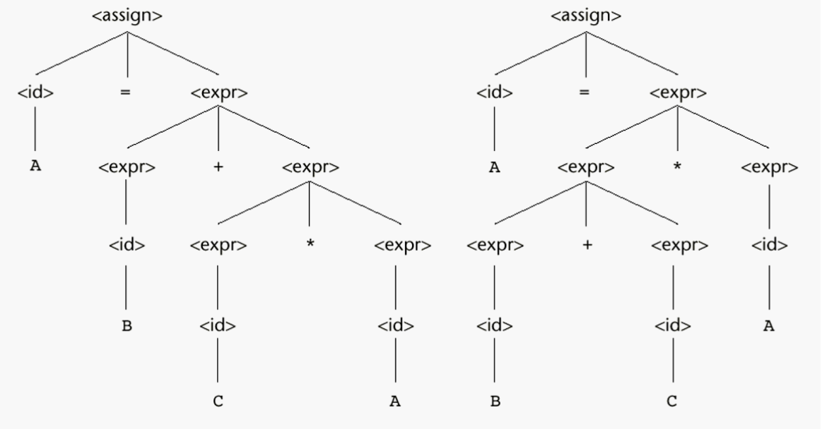
<assign> ::= <id> = <expr>
<id> ::= A | B | C
<expr> ::= <expr> + <expr>
| <expr> * <expr>
| (<expr>)
| <id>
Two Parse Trees
for A = B + C * A

Slide 120
<assign> ::= <id> = <expr>
<id> ::= A | B | C
<expr> ::= <expr> + <expr>
| <expr> * <expr>
| (<expr>)
| <id>
Two Leftmost derivations
for A = B + C * A
<assign> => <id> = <expr>
=> A = <expr>
=> A = <expr> + <expr>
=> A = <id> + <expr>
=> A = B + <expr>
=> A = B + <expr> * <expr>
=> A = B + <id> * <expr>
=> A = B + C * <expr>
=> A = B + C * <id>
=> A = B + C * A
<assign> => <id> = <expr>
=> A = <expr>
=> A = <expr> * <expr>
=> A = <expr> + <expr> * <expr>
=> A = <id> + <expr> * <expr>
=> A = B + <expr> * <expr>
=> A = B + <id> * <expr>
=> A = B + C * <expr>
=> A = B + C * <id>
=> A = B + C * A

Slide 121
<assign> ::= <id> = <expr>
<id> ::= A | B | C
<expr> ::= <expr> + <expr>
| <expr> * <expr>
| (<expr>)
| <id>
Two Rightmost derivations
for A = B + C * A
<assign> => <id> = <expr>
=> <id> = <expr> + <expr>
=> <id> = <expr> + <expr> * <expr>
=> <id> = <expr> + <expr> * <id>
=> <id> = <expr> + <expr> * A
=> <id> = <expr> + <id> * A
=> <id> = <expr> + C * A
=> <id> = <id> + C * A
=> <id> = B + C * A
=> A = B + C * A
<assign> => <id> = <expr>
=> <id> = <expr> * <expr>
=> <id> = <expr> * <id>
=> <id> = <expr> * A
=> <id> = <expr> + <expr> * A
=> <id> = <expr> + <id> * A
=> <id> = <expr> + C * A
=> <id> = <id> + C * A
=> <id> = B + C * A
=> A = B + C * A

Slide 122
A = B + C * A
A = 3 , B = 4, C = 5
3 + 4 * 5
<assign> ::= <id> = <expr>
<id> ::= A | B | C
<expr> ::= <expr> + <expr>
| <expr> * <expr>
| (<expr>)
| <id>
3 + [ 4 * 5 ]
[ 3 + 4 ] * 5

Slide 123
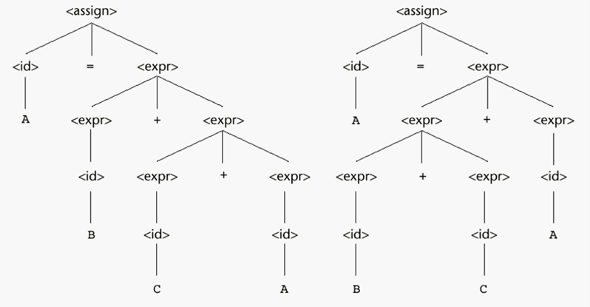
A = B + C + A
A = 3 , B = 4, C = 5
3 + 4 + 5
<assign> ::= <id> = <expr>
<id> ::= A | B | C
<expr> ::= <expr> + <expr>
| <expr> * <expr>
| (<expr>)
| <id>
3 + [ 4 + 5 ]
[ 3 + 4 ] + 5

Slide 124
<assign> ::= <id> = <expr>
<id> ::= A | B | C
<expr> ::= <expr> + <expr>
| <expr> * <expr>
| (<expr>)
| <id>
Single leftmost derivation
for A = B + C
<assign> => <id> = <expr>
=> A = <expr>
=> A = <expr> + <expr>
=> A = <id> + <expr>
=> A = B + <expr>
=> A = B + <id>
=> A = B + C
There is also a single rightmost derivation
And a single parse tree for A = B + C
Finding at least one string with more than a single parse tree
(or more than a single leftmost derivation
Or more than a single rightmost derivation)
is sufficient to prove ambiguity of a grammar

Slide 125
Handling Ambiguity
The grammar of a PL must not be ambiguous
There are solutions for correcting the ambiguity
Operator precedence
Associativity rules

Slide 126
Operator Precedence
In mathematics * operation has a higher precedence than +
This can be implemented with extra nonterminals
<assign> ::= <id> = <expr>
<id> ::= A | B | C
<expr> ::= <expr> + <expr>
| <expr> * <expr>
| (<expr>)
| <id>
<assign> ::= <id> = <expr>
<id> ::= A | B | C
<expr> ::= <expr> + <term>
| <term>
<term> ::= <term> * <factor>
| <factor>
<factor> ::= (<expr>)
| <id>

Slide 127
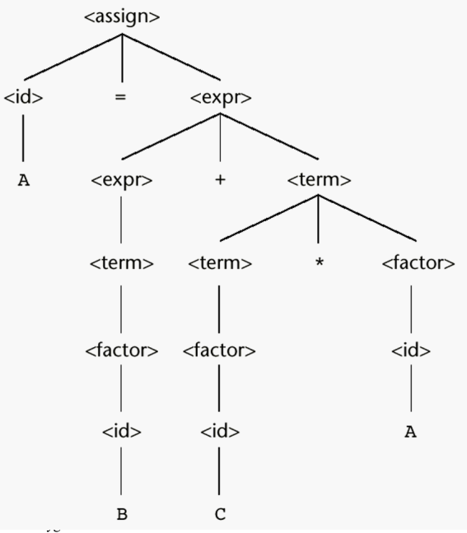
Unique Parse Tree for A = B + C * A

Slide 128
Associativity of Operators
What about equal precedence operators?
In math addition and multiplication are associative
A+B+C = (A+B)+C = A+(B+C)
However computer arithmetic may not be associative
Ex: for floating point addition where floating points values store 7 digits of accuracy, adding eleven numbers together where one of the numbers is 10⁷ and the others are 1 result would be 1.000001 * 10⁷ only if the ten 1s are added first
Subtraction and division are not associative
A/B/C/D = ? ((A/B)/C)/D ≠A/(B/(C/D))

Slide 129
Associativity of Operators
Operator associativity can also be indicated by a grammar
<expr> -> <expr> + <expr> | const (ambiguous)
<expr> -> <expr> + const | const (unambiguous)
<expr>
<expr>
<expr>
+
const
<expr>
+
const
const
Copyright © 2009 Addison-Wesley. All rights reserved.
1-129
Notes:
129

Slide 130
Associativity
In a BNF rule, if the LHS appears at the beginning of the RHS, the rule is said to be left recursive
Left recursion specifies left associativity
<expr> ::= <expr> + <term>
| <term>
Similar for the right recursion
In most of the languages exponential is defined as a right associative operation
<factor> ::= <expr> ** <factor>
| <expr>
<expr> ::= (<expr>)
| <id>

Slide 131
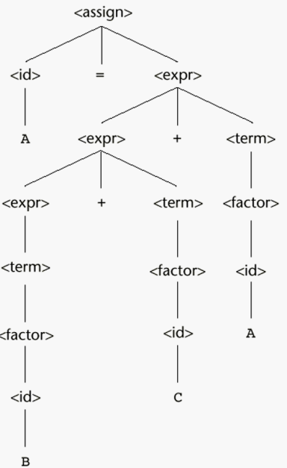
A parse tree for A = B + C + A illustrating the associativity of addition
Left associativity
Left addition is lower than the right addition

Slide 132
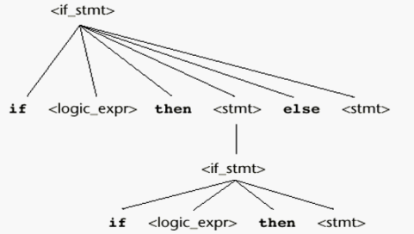
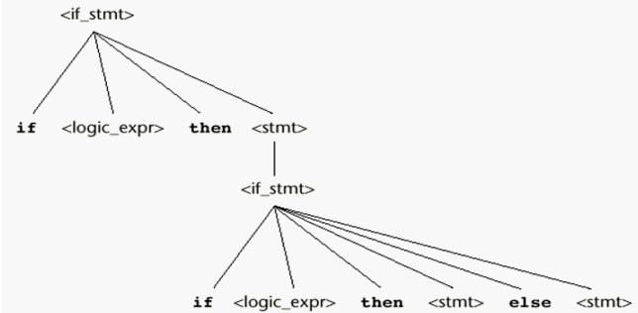
Is this ambiguous?
<stmt> ::= <if_stmt> | <other_stmt>
<if_stmt> ::= if <logic_expr> then <stmt>
| if <logic_expr> then <stmt> else <stmt>
<other_stmt> ::= S1 | S2
<logic_expr> ::= L1 | L2
Derive for : If L1 then if L2 then S1 else S2
L1
L1
S2
L2
S1
L2
S1
S2

Slide 133
An Unambiguous grammar for “if then else”
Dangling else problem: there are more if then else
To design an unambiguous if-then-else statement we have to decide which if a dangling else belongs to
Most PL adopt the following rule:
“an else is matched with the closest previous unmatched if statement”
(unmatched if = else-less if)
Has a unique parse tree
<stmt> ::= <matched> | <unmatched>
<matched> ::= if <logic_expr> then <matched> else <matched>
| any non-if-statement
<unmatched> ::= if <logic_expr> then <stmt>
| if <logic_expr> then <matched> else <unmatched>

Slide 134
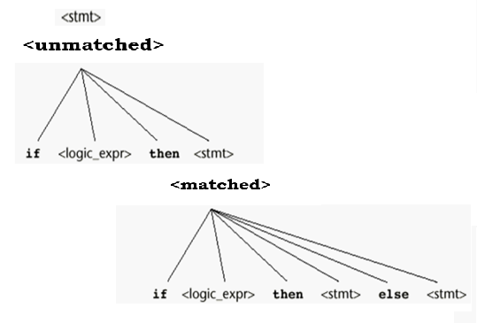
Draw the parse tree
<stmt> ::= <matched> | <unmatched>
<matched> ::= if <logic_expr> then <matched> else <matched>
| <other_stmt>
<unmatched> ::= if <logic_expr> then <stmt>
| if <logic_expr> then <matched> else <unmatched>
If L1 then if L2 then S1 else S2

